Slide 1
European Approach to QA of Joint Programmes
State of play, challenges and barriers
EQAR Members’ Dialogue
28 October 2024

Slide 2
European Approach for QA of Joint Programmes
European Approach, based on ESG & QF-EHEA, and Bucharest Communiqué
(“recognise QA decisions of EQAR-registered agencies on joint and double degree programmes“)
Cooperating HEIs
need programme
accreditation/eval.
Cooperating HEIs are “self-accrediting”
for programmes, i.e. accredited/
evaluated/audited at institutional level
Single accreditation/eval.
of JP, based on agreed
Standards & Procedure,
by any EQAR-reg. agency
Joint internal QA review
of the JP (in line with ESG), may use
agreed Standards, external
review takes account of HEIs' internal
Recognised to fulfil QA
requirements in all
countries involved

Slide 3
European Approach for QA of Joint Programmes
Before | After
Multiple, fragmented reviews | Single review, by one EQAR-registered agency
Combining various national rules and criteria | Agreed Standards, based on ESG & QF-EHEA
Complex procedures, ad hoc design | Agreed Procedure

Slide 4
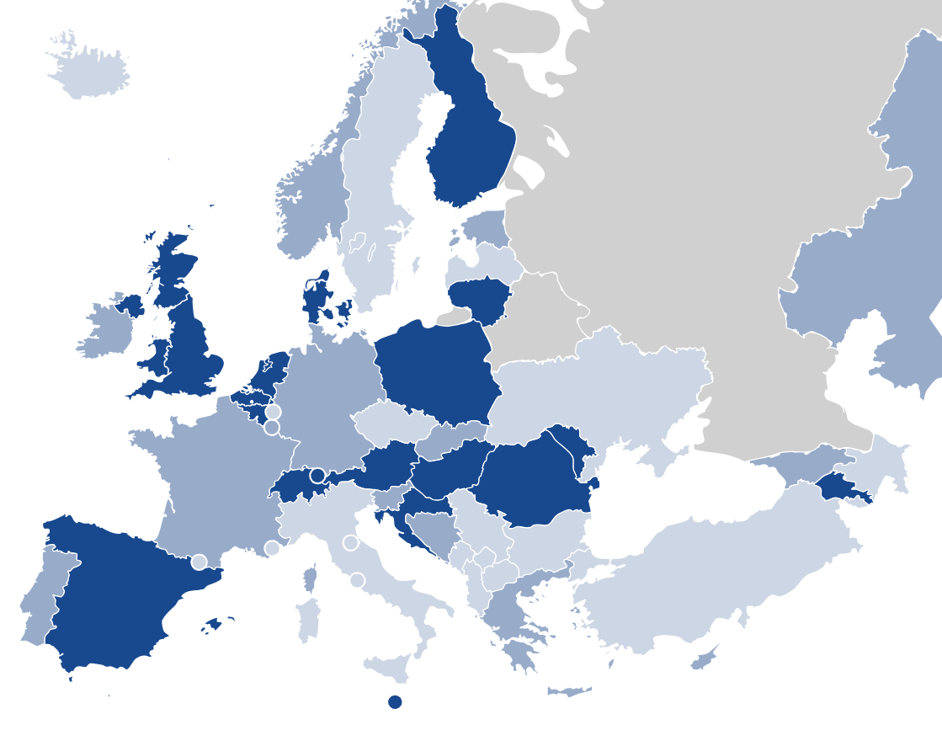
Where it is Available
All higher education institutions are able to use the European Approach
Some higher education institutions, or only under specific conditions
Cannot be used to satisfy national QA requirements

Slide 5
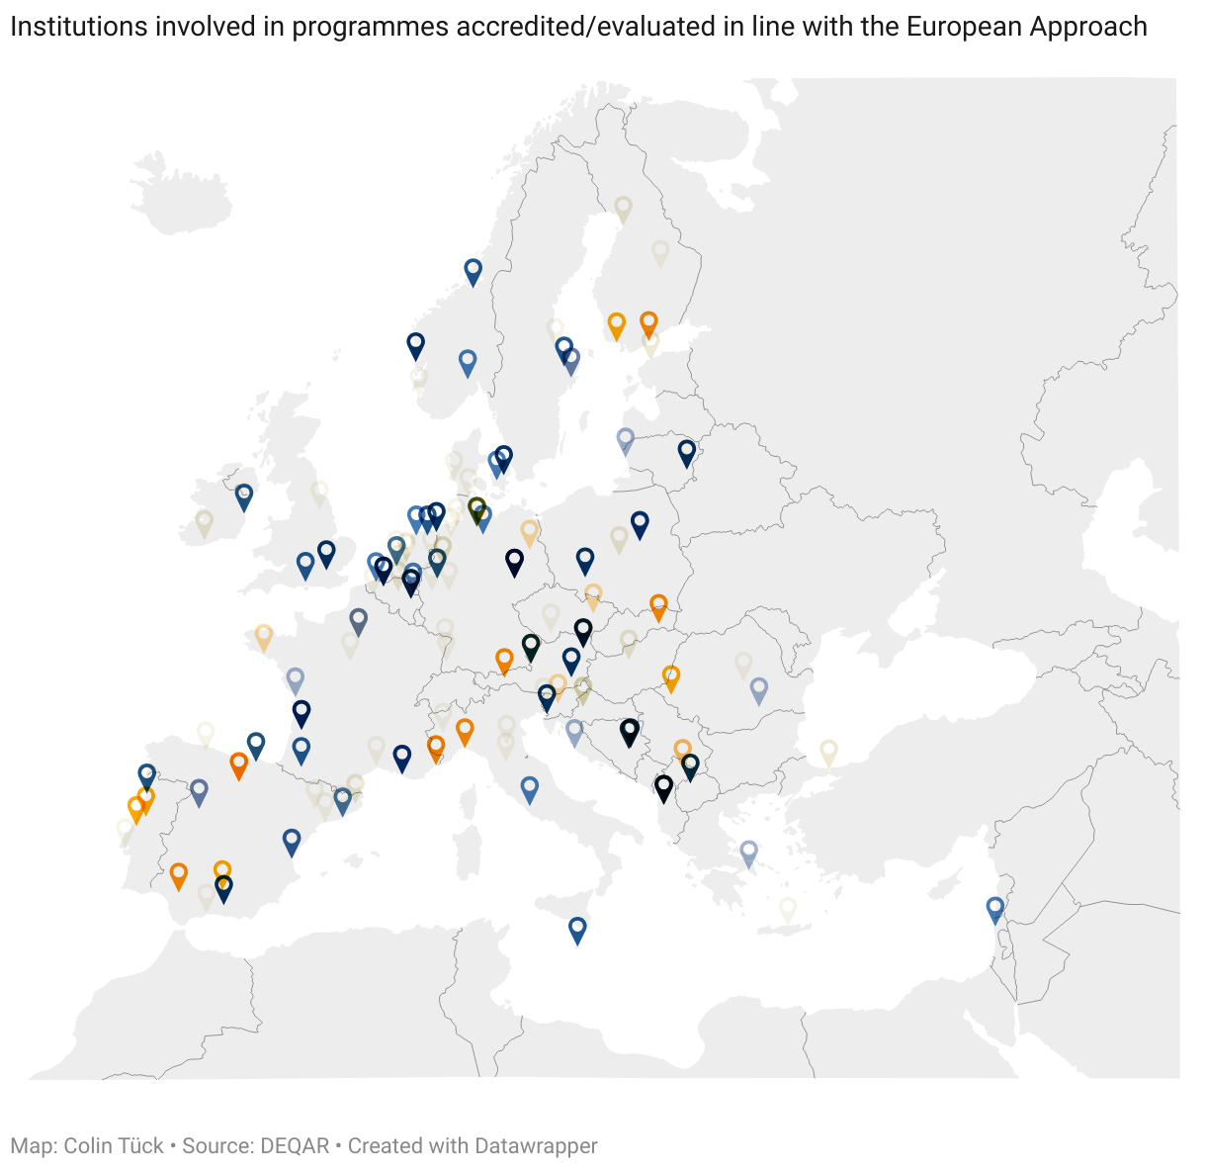
Uptake

Slide 6
European Approach – Challenges
Regulative/legal obstacles related to the availability of the EA
Other regulations or institutional policies and practices
  Credit ranges per cycle – different than in QF-EHEA
  ECTS workload ranges
  Curricula structure
  Fixed lists of disciplines/fields – difficult for interdisciplinary programmes
Practical issues
  Tuition fee regulations
  Selection of students
…

